Slide 1
JUNE 2024 INCIDENT PERIODICAL
COAL MINES INSPECTORATE

Slide 2
Risk Control Effectiveness.
This month RSHQ have more examples of the inability of mine investigation outcomes to prevent repeating incidents.
Vehicle rollovers
Lifting and slinging failure
Working over stockpile valves
Collisions

Slide 3
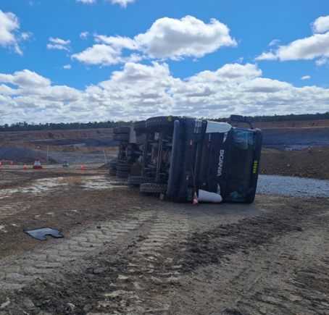
Vehicle rollovers.
The driver of a stemming truck travelling down a ramp at about 20kph planned to make a U-Turn and return up the ramp.
The ramp gradient and vehicle speed, combined with the loose load material overbalanced the trailer and toppled the prime mover as well.

Slide 4
Vehicle rollovers.
The driver of a light vehicle travelling in dawn morning light misjudged a turn, left the road into rough terrain and rolled the light vehicle onto its side.
Skill level, overconfidence, fatigue, driver inattention due to radios, phones or other distractions may have played a part in both this and the previous event.

Slide 5
Lifting and slinging.
A lifting plan to unload an empty 40-foot container failed to prevent an uncontrolled movement of the container.
A recalcitrant twist lock released when the crane lifting forces exceeded its holding capacity. The surplus stored energy caused the container to swing toward the truck cab when the twist lock released.
By luck and not design, the container did not make contact with the cab, nor move appreciably sideways.

Slide 6
The execution of the lift plan failed to stop the lift when the twist lock caught. There are many possible outcomes when a lift does not go to plan, most of them unwanted.

Slide 7
Dozers on Stockpiles
During a nightshift, a bulldozer operator walked over the cavity zone above a feed valve below the stockpile.
Feed valves are a known hazard. Industry know that administrative controls will not prevent such events.
Remote operation of dozers removes the coal mine worker from any exposure to this hazard.

Slide 8
COLLISIONS
Nighttime and its effect on operator visibility appears a common factor in the following events. Fatigue may also have been a contributor.
A very significant contributor for two of the events was the failure of coal mine workers to even communicate with one another.

Slide 9
Collisions
In the first two events, no communication was made between the machine operators before the collisions occurred.
Entering the working area of heavy machinery must be done in accordance with the processes designed and implemented to prevent contact between machines.

Slide 10
Collisions
Prime mover driver did not communicate with the loader operator when entering the work area.
Loader operator reversed and pushed the prime mover sideways.
Communication occurred between the operators following the collision.

Slide 11
Collisions
Loader was travelling around a stockpile with bucket elevated.
Dump truck operator travelling the opposite direction had not communicated with the loader operator.
Communication occurred between the operators following the collision

Slide 12
Collisions
The operator of a light vehicle did not recognise the parked, idling MH40 lights as being a vehicle on the road in front of them until it was too late to avoid contact.

Slide 13
Board of Examiners Update
Law Exams for Deputy, First Class and Second Class Certificates of Competency are recommencing from 15 July.
Application fees will remain the same for the 2024-25 financial year.
New online forms and payment collection will replace the current application process. More details coming soon.

Slide 14
NOTICE BOARD
QUICK LINKS
COMMUNICATIONS
Board of Examiners
RSHQ Consultation
Recognised Standard 01
PUBLISHED
OHHN Meeting
23 October 2024
Registration for the PCS Scheme
Periodicals
Recognised Standard 13
PUBLISHED
ERZC Forums
Postponed
Mining Hazards Database
Coal Mining Safety and Health Act 1999
Recognised Standards
RSHQ Forums
RECENT SAFETY NOTICES
Safety Alert 449
Haul truck hits excavator
Safety Alert 448
Loader falls into stope void over vertical edge
Safety Alert 447
Operator injured after fall from dump truck ladder
Safety Bulletin 221
Coal mine worker loses consciousness following the inhalation of nitrogen

Slide 15
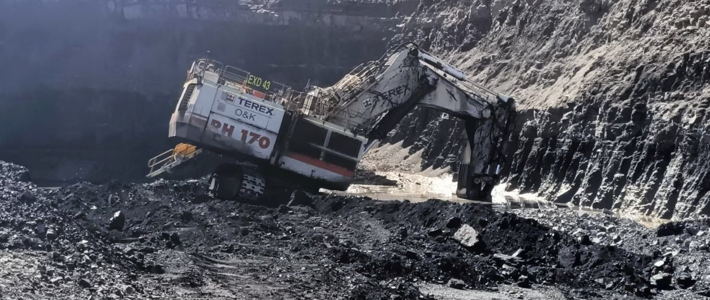
www.rshq.qld.gov.au

