Slide 1
May 2024 Incident periodical
May 2024
COAL MINES INSPECTORATE

Slide 2
Risk Control Effectiveness
This month’s periodical looks at four reported HPIs:
Pick & carry cranes roll over whilst unloading pipework.
Jack locking system failure.
Rotating dragline contacts coal mine worker.
Equipment fires.
These types of HPIs are reported regularly suggesting that accident investigations are not finding the effective risk controls to prevent incidents from happening again.
Administrative controls recommended following an incident are at the lower end of effectiveness
Recycled failed lower-order (administrative) controls do not prevent the same sort of incident from happening again.
HPI and accident investigations must find the risk controls that prevent the incidents from happening again.
Higher-order controls including engineering, isolation, substitution and elimination are more effective

Slide 3
Pick & carry cranes roll over whilst lifting pipework
Whilst unloading a rack of poly pipe utilising two 25t Franna cranes (dual lift), the first crane lost stability and started to tilt just before tipping onto its side. This has caused the second crane to lose stability and tip onto its side.
One of the crane’s system data registered a 2-degree increase in slide slope deration. This slide slope increase put this crane outside of its operating limits of 5 degrees.
Sites must ensure preparation of the pad angle is considered for all lifting activities. Review the pad preparation process of the specification to ensure a range can be selected and requirements are clearly understood by production or whoever is cutting the pad. Associated risk assessment documentation should include correct crane selection and a risk assessment as part of the process for dual lifts.

Slide 4
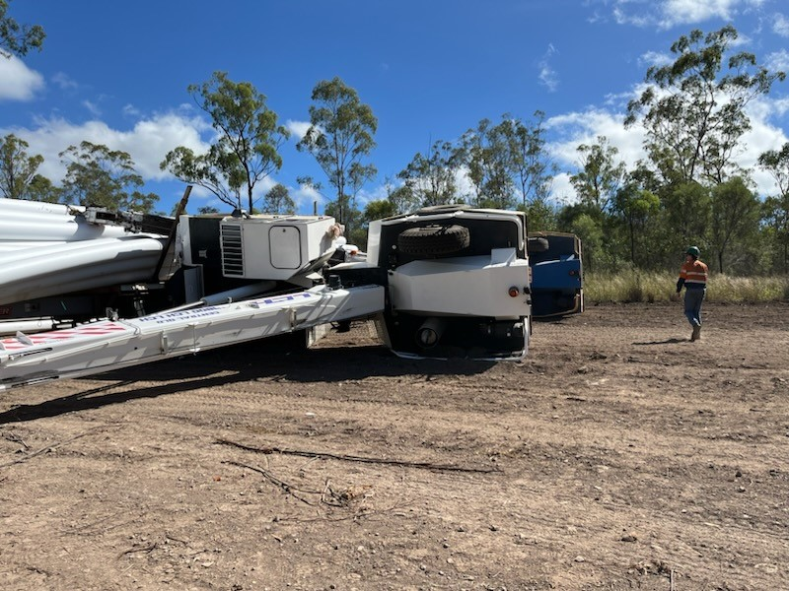
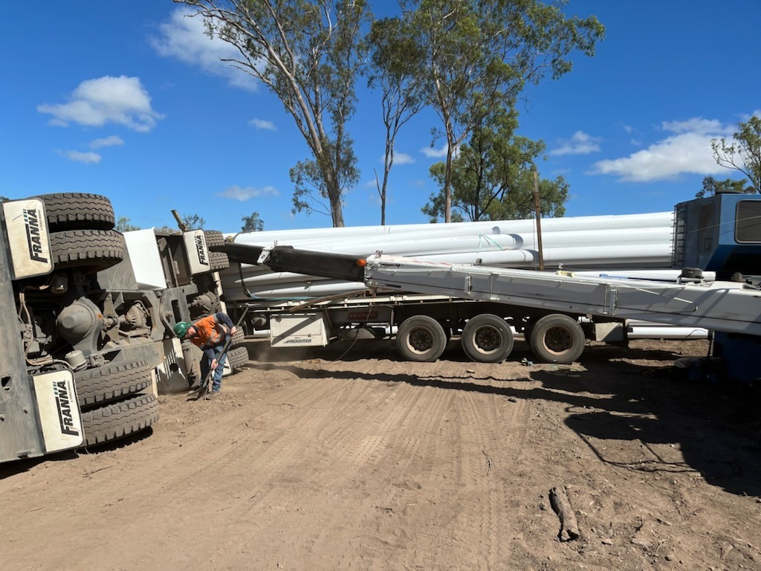
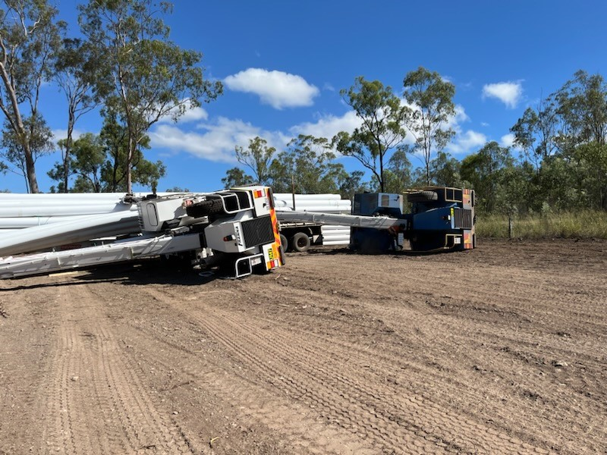
Franna cranes roll over whilst lifting pipework

Slide 5
Jack locking system failure
Following the changeout of the position 1 tyre, a tyre fitter was lowering a truck using a pneumatic 200-tonne jack when the jack locking system failed.
This resulted in some bolts from the guard, bolts from the locking clamp rings failing or shearing, and the locking mechanism coming apart with some pieces landing up to 9 metres from the jack's location.
The failure was due to not allowing the Jack to raise enough to disengage the locking mechanism.
Sites must ensure formal training is in place for the use of jacks, and there is a system of work in the SHMS that allows tyre fitters to be familiarised with different style Jacks.
If possible, the fitment of a dead man system is recommended for the sites specific jack brands.

Slide 6
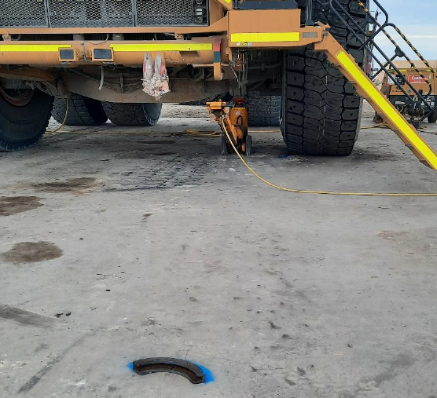
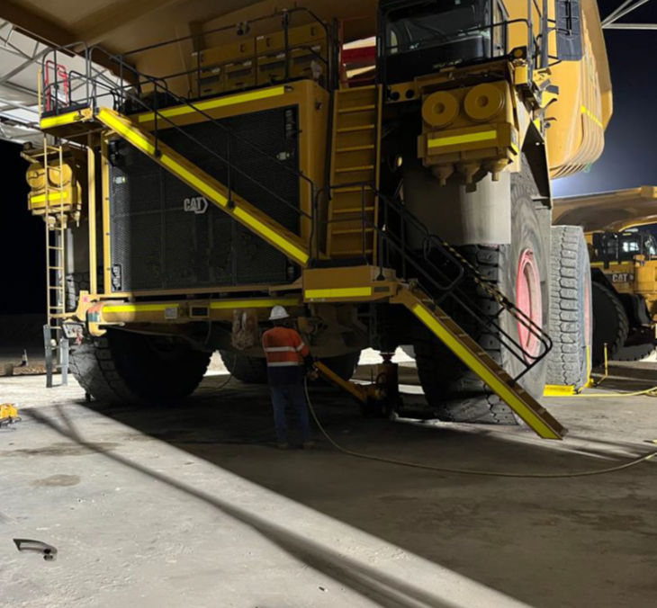
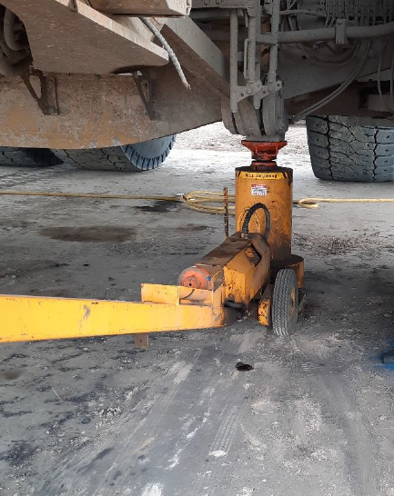
Jack locking system failure

Slide 7
Coal mine worker struck by rotating dragline
In January 2024 a CMW within the dragline operational swing boundary was struck by a rotating dragline upon completion of cable relocation works (refer Safety Alert No. 444).
In 2021 a CMW died after being injured in a similar incident (refer Safety Alert No. 403).
Multiple HPI reports of draglines contacting manned and unmanned mobile equipment have been received by the Inspectorate (refer Safety Bulletin No. 162).

Slide 8
Coal mine worker struck by rotating dragline
Mines must review SHMS procedures, controls and their effectiveness for working around plant.
Reliance on administrative controls has proven to be ineffective and higher order controls including collision avoidance systems must be considered.

Slide 9
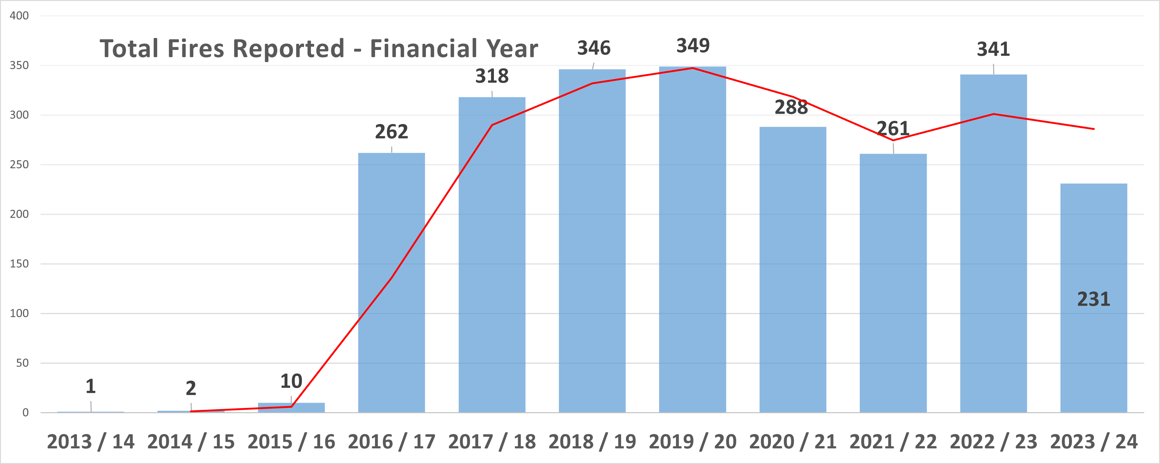
Equipment fires
Equipment fires are not reducing within the coal mining sector

Slide 10
Equipment fires
Noticeable trending areas for fire mitigation include:
Dozer and truck hydraulic fire:-
Fire occurring soon after maintenance activities.
Poor workmanship or lack of an exit strategy to ensure work completed is of a high standard.
Poor hydraulic hose strategies – not replacing critical hoses at the appropriate intervals.
Dozer and truck electrical fire (HV and LV):-
Fires initiated from the third-party fitment of isolators and E Stops. – Do you have a strategy to inspect these components regularly internally?
Poor workmanship and securing of wiring looms.
Dozer and truck engine oil fires:-
Fire occurring soon after maintenance activities.
Poor workmanship or lack of an exit strategy to ensure work completed is of a high standard.

Slide 11
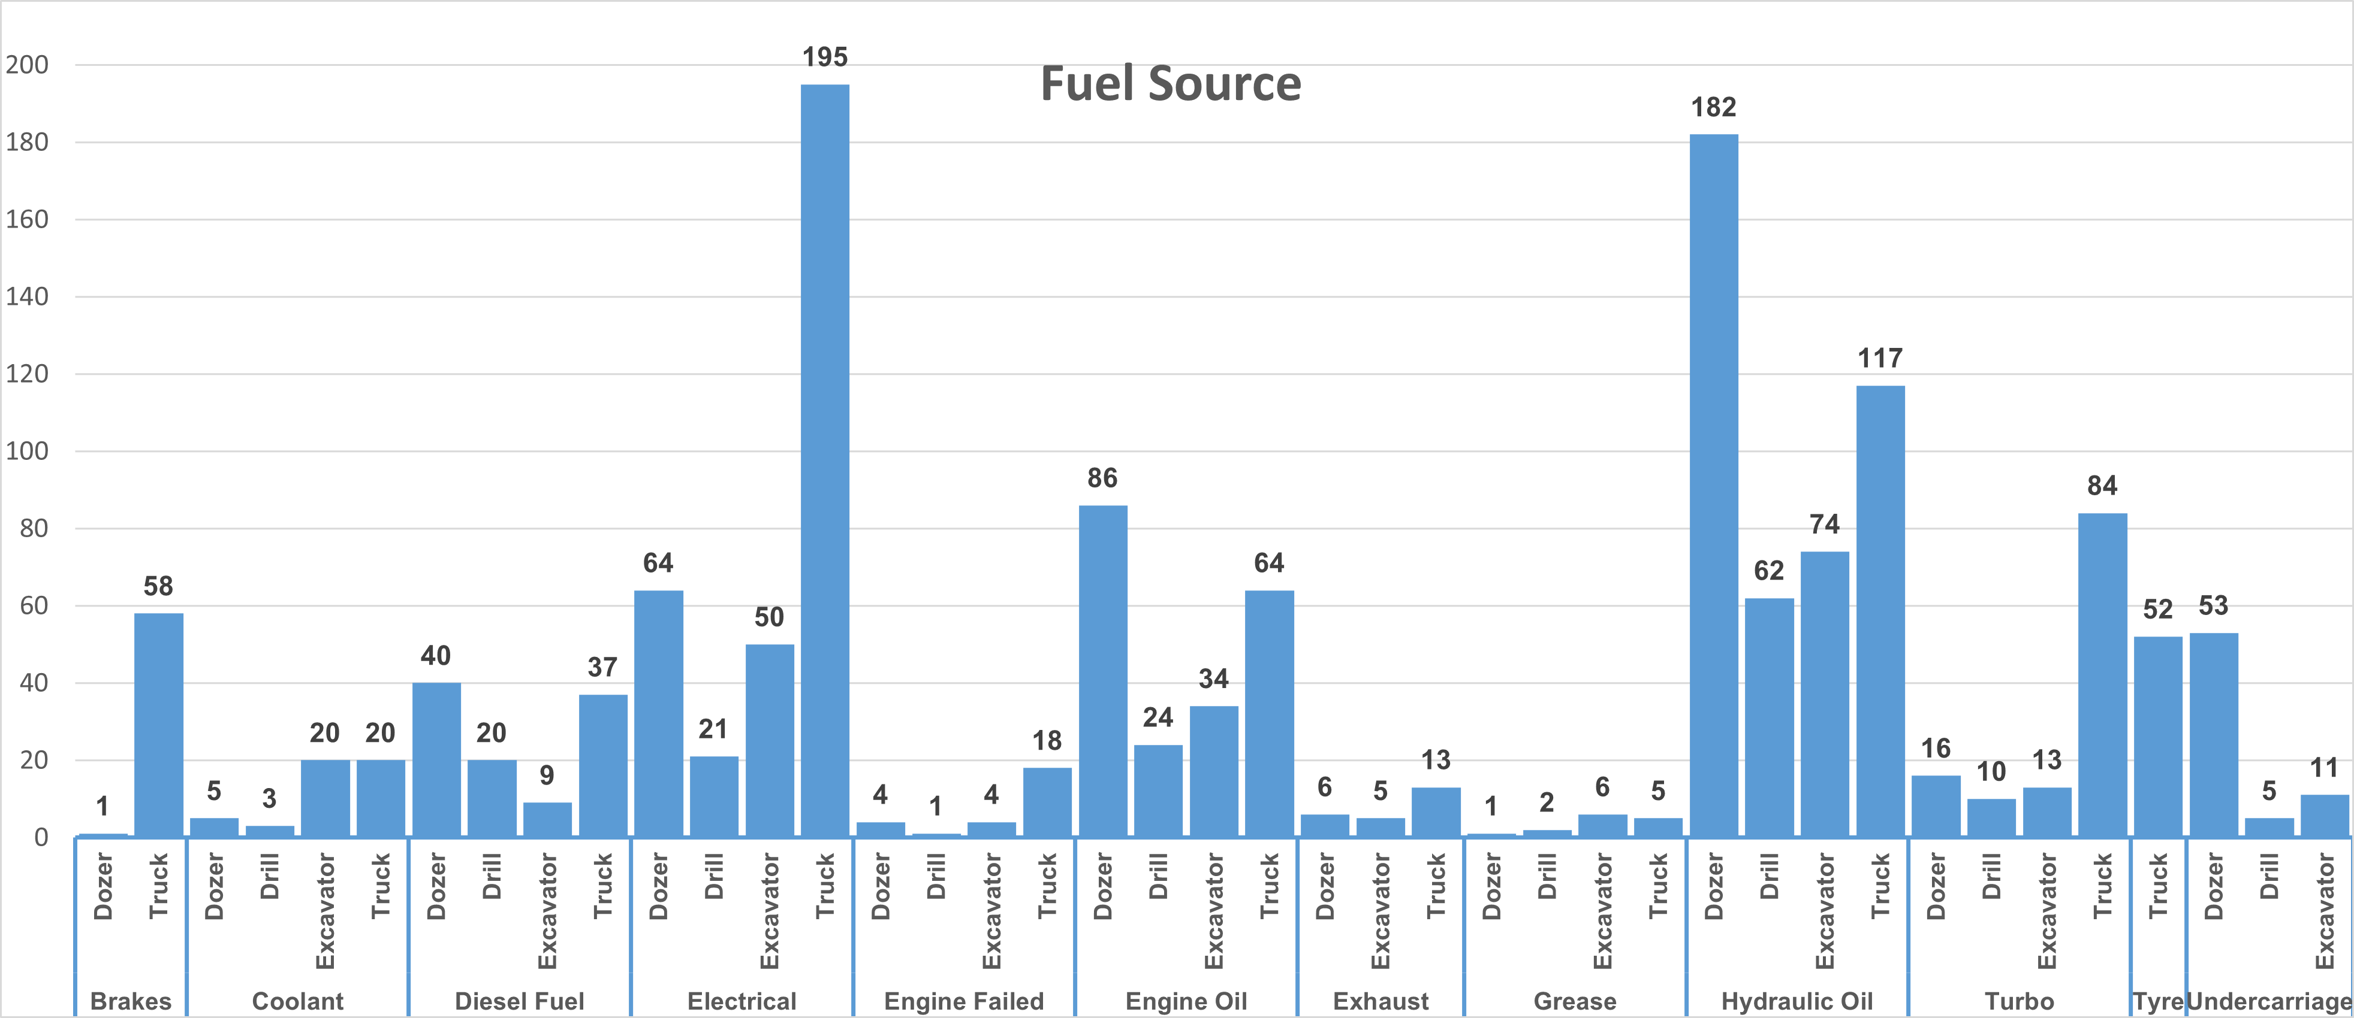
Equipment fires

Slide 12
Equipment fires
RSHQ is supporting further initiatives and actions aimed at reducing fires on mobile equipment and fixed plant at your site.
Sites must ensure that a robust exit assessment of mobile and fixed plant is integrated and performed after maintenance activities.
Sites must ensure that component and hose strategies are aligned to mitigate the risk of not completing scheduled critical hose replacements.
Sites must ensure hose replacements and intrusive maintenance tasks are carried out by competent personnel.
Sites must ensure hosing is replaced like for like and to the same OEM standard. Competent personnel must only be used for site hose fabrication.

Slide 13
NOTICE BOARD
QUICK LINKS
COMMUNICATIONS
Board of Examiners
RSHQ Consultation
Industry Notification
Counterfeit product
Review of 2023 exposure data
FREE Registration for the PCS Scheme
Periodicals
DPM Forum
12 June 2024
MEM Forums
May + June 2024
Mining Hazards Database
Coal Mining Safety and Health Act 1999
Recognised Standards
QMI Forums
RECENT SAFETY NOTICES
Safety Bulletin 220
Continuous miner cutter head stop-pin ejects hits CMW
Safety Bulletin 219
Tow hitch failures
Safety Bulletin 218
Pick & Carry Crane Incident
Animation Video
Safety Alert 446
Electric shock from accessing a high voltage enclosure

Slide 14
To subscribe to communications from the Queensland Mines Inspectorate please email
QldMinesInspectorate@rshq.qld.gov.au
www.rshq.qld.gov.au

